Slide 1
Lesson 3.1
Introduction to web app architecture

Slide 2
Learning Outcomes
Use the concept of web architecture
Define N-tier web architecture and single page web architecture
Explain the modern web architecture components and trends:
Application layer (business logic)
Presentation layer
Data layer
Client/server

Slide 3
Terminology
Client:
A user-friendly representation of a web app’s functionality that a user interacts with.
Examples: website on a browser, smartphone app
Server:
A computer program or device that provides services or resources (e.g. data, files, applications, computing power) to clients over a network.
Client-server architecture:
A network architecture in which clients request services or resources from servers over a network, and the server processing that request and sending back a response to the client.
Web application architecture:
The structural design of a web-based application, including its components, interactions, and technologies used to develop and deploy it.
Encompasses various layers and components that work together to deliver functionality to users over the web.

Slide 4
So you want to build a web application…
Common problems and decisions:
How should we build it?
What technology should we choose?
Can we use standard components?
How will our web application cope with large numbers of requests (scalability)?
How do we protect against attacks, viruses, malicious data access, denial of service?
How do we manage the many different data views (e.g. various roles and users)?
The choice of which web application architecture to use is an important and challenging decision.

Slide 5
Design Patterns
Design patterns are a general and reusable solution to a commonly occurring problem in the design of software.
Provides a template for how to solve a problem that has been used in many different situations.
Design patterns are not a finished design.
The pattern must be adapted to the application you are trying to build.
Examples of software architecture design patterns:
Client-Server
Model-View-Controller
Single-Page Application
Peer-to-Peer

Slide 6
N-Tier Architectures
The N-tier architecture (also called multi-tier architecture) is an industry-proven software architecture model.
“N” refers to the number of tiers or layers that are being rendered by distinct IT environments under a client-server design pattern:
1-tier
2-tier
3-tier
…
An N-tier application can and usually is distributed among separate servers, data center networks, and even geographies.

Slide 7
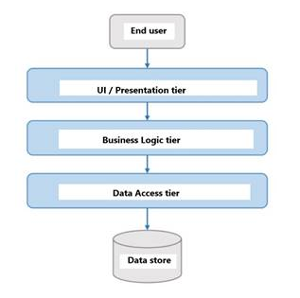
N-Tier Architectures
Consist of 3 component layers:
Presentation/UI
HTML, CSS, JavaScript
Application/Business Logic
Node, Python, PHP, Java, C#
Data/Persistence
Database management system, JSON
N-tier architectures try to separate the components into different tiers or layers.

Slide 8
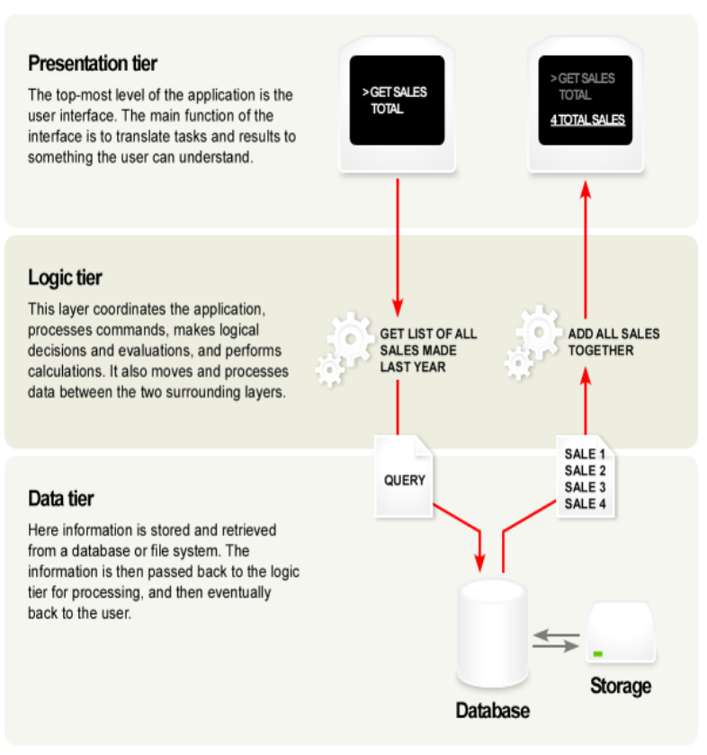
N-Tier Architecture
Presentation Layer
“Front-end”
Provides the user interface
Handles the interaction with the user
Should not contain application/business logic or data access

Slide 9
N-Tier Architecture
Application/Business/Logic layer:
“Back-end” or “middleware”
The set of rules for processing information
Can accommodate many users
Should not contain presentation or data access

Slide 10
N-Tier Architecture
Data Layer:
“Back-end”
The physical storage layer for data persistence
Manages access to the database or file system
Should not contain presentation or application/business logic

Slide 11
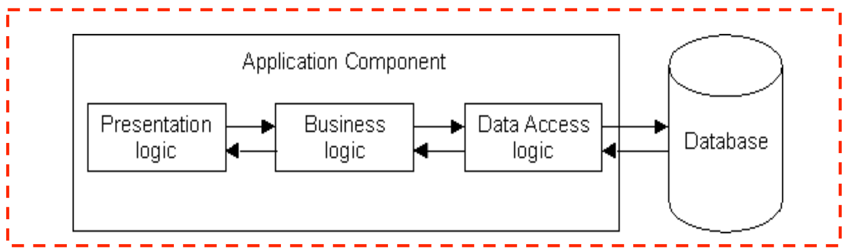
1-Tier Architecture
All 3 layers are on the same machine. This is what you are building in your project.
Presentation, logic, and data layers are tightly connected.
Problems:
Scalability - single processor means hard to increase volume of processing
Maintenance - changing one layer requires changing other layers

Slide 12
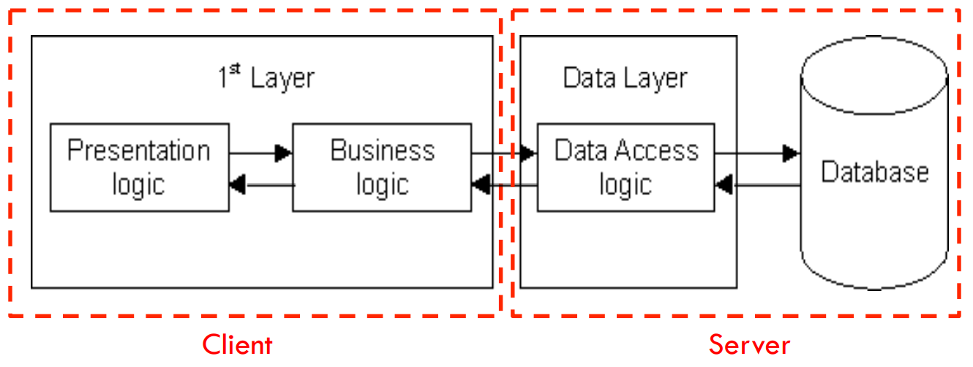
2-Tier Architecture
Client-server architecture:
Database runs on a server which is separate from the client
Presentation and application layers are still tightly connected.
Advantages:
Easy to switch to a different database
Problems:
Heavy load on server
Potential congestion on network

Slide 13
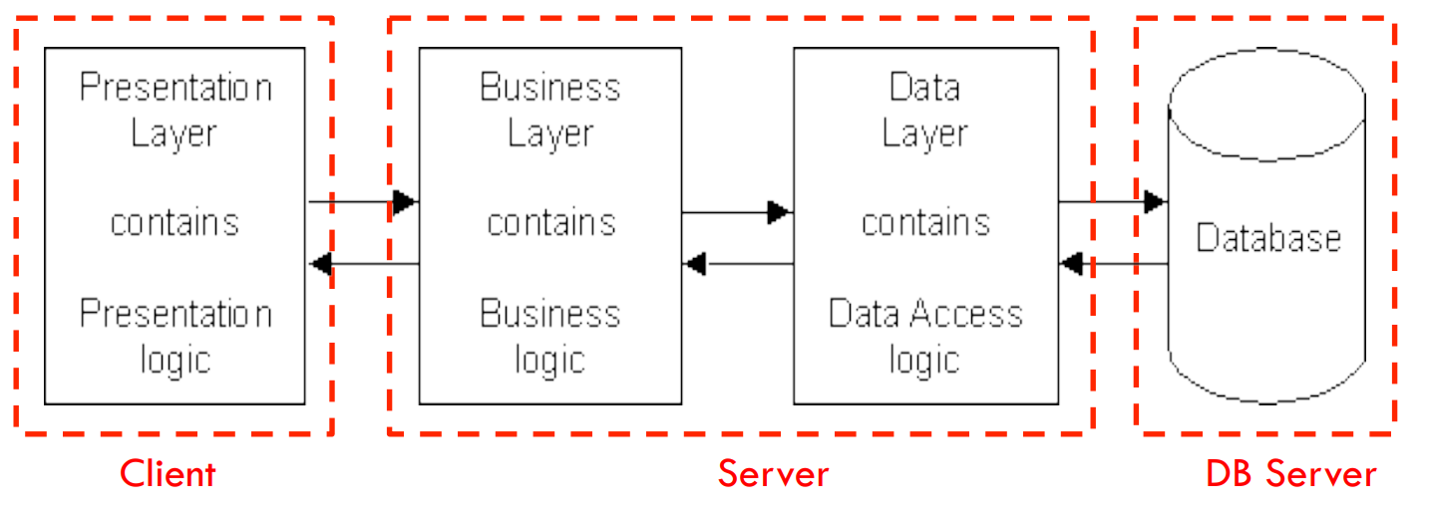
3-Tier Architecture
Client-server architecture. Presentation, application, and data layers are disconnected.
Advantages:
Faster development through division of work
Independence of layers
Easier to maintain
Components are reusable

Slide 14
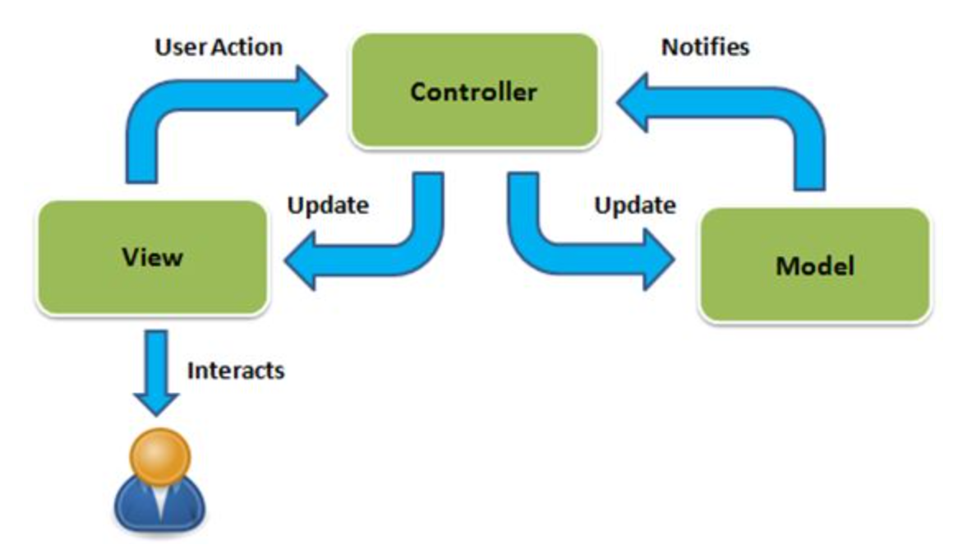
Model-View-Controller Architecture
Model-View-Controller (MVC) is a type of software development architectural design pattern.
Used to break down three primary aspects of any application into separate environments:
Decouples data (model) and presentation (view).
A controller handles requests, and coordinates between the model and the view.
Popular and effective framework for web applications, websites, web services, and interactive web apps.

Slide 15
Model (of MVC)
The model is the brain of the application.
In charge of obtaining and manipulating data.
Communicates with data storage options, such as database management systems or file servers.
The data itself can be stored in databases or files (e.g. JSON).
Independent of view. One model can link to many different views.
Duties:
Defines the data structure (e.g. objects and classes).
Provides “meaning” to the raw data.
Performs queries like select, insert, update, and delete.
Interacts with the controller.

Slide 16
View (of MVC)
The view provides the user interface.
Renders the model in a view suitable for interaction.
Multiple views can be created for a single model, each serving different purposes.
Uses a template engine to provide functionality for dynamic data.
Duties:
Display data to the user.
Responds to user inputs.
Does NO processing.
Interacts with the controller.

Slide 17
Controller (of MVC)
The controller serves as a link between the model and the view.
Receives user inputs from the view, processes it, requests data from the model, processes it, then passes the data to the view.
Duties:
Respond to actions taken by the user on the view.
Process the business/application logic.
Sends messages to the model.

Slide 18
MVC Control Flow

Slide 19
MVC Architecture Advantages
Clarity of design
Allows developers to focus on one aspect of execution at a time.
Easier to construct and maintain
Allows for fast and parallel development.
Separate components makes problems easier to find and resolve.
Adaptable. You can change the look and feel without changing the logic or data structure.
Can maintain multiple views of the same data (e.g. list view vs detailed view, or mobile device vs desktop).

Slide 20
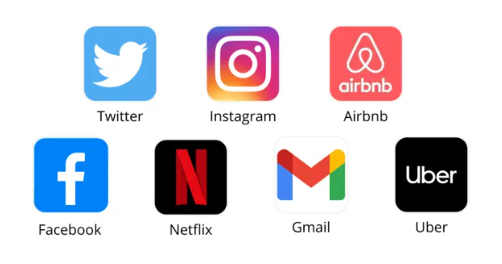
Single-Page Application (SPA)
A Single-Page Application (SPA) is an application or website that loads only a single page and rewrites that page with new content fetched from a web server as the user interacts with it.
Renders JavaScript code directly in the browser.
There are no page reloads when the user navigates the website.
A Multi-Page Application (MPA) is a more traditional website architecture that contains multiple static pages that load independently as a user navigates the site.

Slide 21
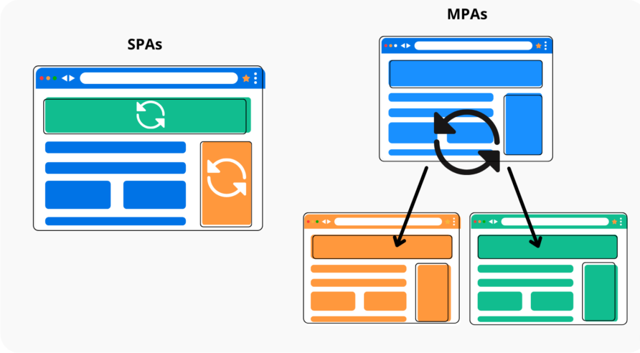
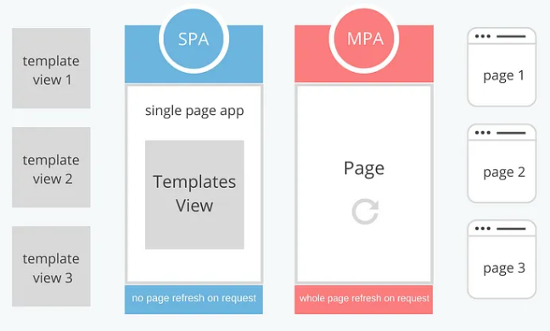
SPA vs MPA

Slide 22
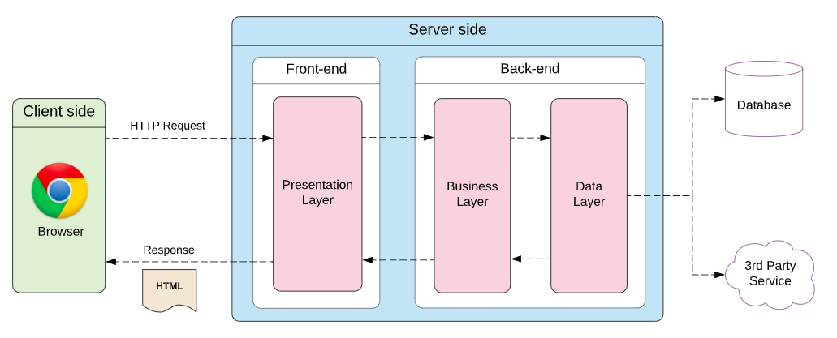
Traditional Web Application Architecture

Slide 23
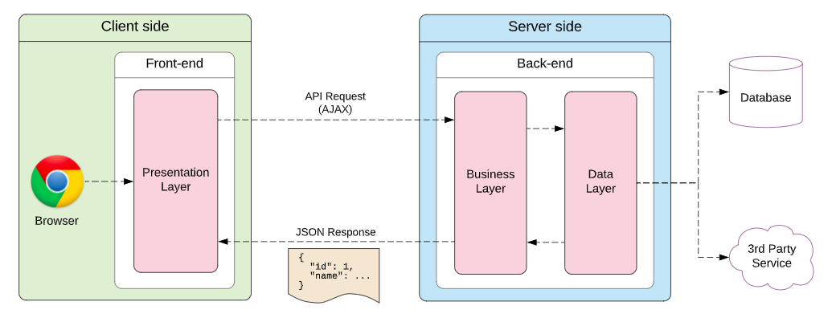
Single-Page Application Architecture

Slide 24
SPA vs MPA
 | SPAs | MPAs
Performance | Faster loading times (except initial load) | Slower loading times (except initial load)
Debugging | Difficult | Easy
Development | Fast | Slow
Maintenance | Fast | Slow
Security | Simplified | Challenging
SEO | Challenging | Easy
Cost | More expensive | Less expensive
Scalability | Difficult | Easy

Slide 25
Lesson 3.2
Modern Web Application Programming

Slide 26
Learning Outcomes
Create Asynchronous Application
Use Async/Await
Use promise and async/await
Create fast and modern web application

Slide 27
Synchronous JavaScript
Synchronous means to be in a sequence or concurrent in time.
In JavaScript, that means every statement of code gets executed one by one. A statement must wait for the previous statement to get executed before it can have a turn.
}
Your JavaScript code
With synchronous code each line must complete before the next line can start. Most languages work this way (C#, SQL, Python).

Slide 28
Asynchronous JavaScript
Asynchronous means to not be in a sequence or concurrent in time.
In JavaScript, that means code can be executed immediately. Callback functions are often used with asynchronous functions.
Example: https://codepen.io/michael-dorsey/pen/ExJarKJ

Slide 29
Asynchronous JavaScript
Synchronous programming works well in most scenarios. However, it is a blocking approach.
Even if two tasks are independent of each other, one task must wait for the other task to finish.
What if you don’t want the JavaScript engine to halt (block) all execution and wait for a specific task to finish?
Asynchronous programming solves that problem.
Examples:
Fetching data from a server
Using a module to process a specific task
Verifying a credential with a 3rd party
Uploading a file
Execute a function with a timed delay

Slide 30
Asynchronous JavaScript
We can classify most asynchronous JavaScript operations with two primary triggers:
Browser API/Web API events or functions
Examples: setTimeout(), or event handlers like click, mouse over, scroll.
Promises.

Slide 31
Restaurant Example
Two servers work at a restaurant.
Each server is responsible for covering half of the tables in the restaurant.
After taking a table’s orders, Server 1 must wait in the kitchen until each order is ready to be served.
After taking a table’s orders, Server 2 can leave the order in the kitchen and return to serve other customers, then return to the kitchen when the order is ready.
Which server will have happier customers?

Slide 32
Restaurant Example
What happens when a line of code takes a long time to finish? The rest of the program must wait.
}
Your JavaScript code
The black bar represents a line of code that takes some time to finish. The line after it has to wait, which holds up the entire program.

Slide 33
Restaurant Example
JavaScript programs can only do one thing at a time. So if the code is "tied up", then everything appears to stop.
}
Your JavaScript code
While we wait for that slow line of code, the browser appears to freeze. You can't scroll or click on anything. Users don't like this.

Slide 34
Restaurant Example
This happens a lot with API calls. They take time to finish, since other computers and the internet are involved.
Your JavaScript code
}
Fast fast fast
fetch(url);
}
This API call is SLOW and everything has to wait!!!
Fast fast fast

Slide 35
Restaurant Example
What if we didn't have to wait for slow operations to finish? What if we could receive some kind of signal when a slow operation is finally done?
In JavaScript, we do this using promises. A promise is a signal that some slow operation has finally completed.
Your JavaScript code
fetch(url);
When the slow operation is finally done, run this code.
The main code is not delayed.

Slide 36
Restaurant Example
In a busy restaurant, a server must cope with slow operations like waiting for the kitchen.
Your server's activities
Go to next table.
Explain the daily special.
Take order from customer.
Send order to kitchen.
When the food is ready,
deliver to customer's table.
Go to next table.
Explain the daily special.
Go to kitchen.
Take order from customer.
Pick up order.
Deliver to table.
All customers get fast service.

Slide 37
Promise
A promise is a way for a JavaScript function to return a result at a future time. We use promises to deal with delayed-response scenarios such as API calls.
“I promise to give you a result!”
The Promise object represents the eventual completion (or failure) of an asynchronous operation and its resulting value.
A Promise is in one of these states:
Pending: initial state.
Fulfilled: meaning that the operation was completed successfully. The promise was kept.
Rejected: meaning that the operation failed. The promise was broken.
A promise is said to be settled if it is either fulfilled or rejected, but not pending.

Slide 38

Create a Promise Object
To create a promise, you need to create an instance object using the Promise constructor function.
Syntax:
The Promise constructor function takes in one parameter: a function that defines when to resolve the new promise, and optionally when to reject it.
resolve is a function with an optional parameter representing the resolve value. It will be called if the job finished successfully.
reject is a function with an optional parameter representing the reason why the promise failed. It will be called if an error has occurred.

Slide 39
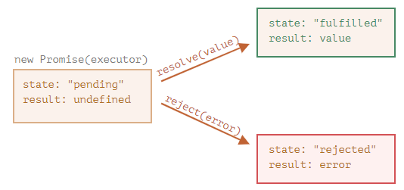
Create a Promise Object
The code inside the Promise object runs automatically and attempts to perform a job. When it is finished with the attempt, it calls resolve if it was successful or reject if there was an error.
The promise object returned by the new Promise constructor has these internal properties:
State — initially "pending", then changes to either "fulfilled" when resolve is called or "rejected" when reject is called.
Result — initially “undefined”, then changes to “value” when resolve(value) is called or “error” when reject(error) is called.

Slide 40
Use a Promise Object
The properties state and result of the Promise object are internal. We can’t directly access them.
Instead, we use the methods .then() and .catch() for that. They are called consuming functions.
Consuming functions receive the result or error. This is how we use a promise object.

Slide 41
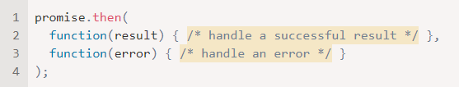
Use a Promise Object
.then() can be used to consume a promise object.
Syntax:
The first argument is a function that runs when the promise is resolved and receives the result.
The second argument is a function that runs when the promise is rejected and receives the error.

Slide 42

Use a Promise Object
.catch() can also be used to consume a promise object if we are only interested in errors.
Syntax:
The argument is a function that runs when the promise is rejected and receives the error.
Note: this is the same as doing promise.then(null, someFunction);
It is a shorthand.
Example 1: https://codepen.io/michael-dorsey/pen/bGJNEwp
Example 2: https://codepen.io/michael-dorsey/pen/OJGPdgj

Slide 43
Practice Activity
Update a JavaScript program that simulates rolling a die using promises.
Success occurs when the rolled number is 6, and failure occurs for all other values (1-5).
Instructions:
Download the file “Promise-Dice-Activity-Starter.html” from D2L > Class Resources.
Complete the three TO DO sections to finish the program.

Slide 44
Group Project Check-in
What did your team accomplish since our last check-in?
What will your team accomplish by the next check-in?

Slide 45
For next class
Read Lesson 3.2 and do Learning Activities 3.2.3, 3.2.4, 3.2.5.
Assessments Reminder:
Group Project due August 22, 11:59pm.
All assessment dates have been posted in D2L.
See the “Assignments Policy” for late submission procedures.

Slide 46
References
https://www.ongraph.com/what-is-mvc-architecture-in-a-web-based-application/
https://researchhubs.com/post/computing/web-application/the-model-view-vontroller-design-pattern.html
https://www.cs.toronto.edu/~mashiyat/csc309/Lectures/Web%20App%20Architectures.pdf
https://www.guru99.com/n-tier-architecture-system-concepts-tips.html
https://www.c-sharpcorner.com/article/micro-services-vs-n-tier-architecture/
https://www.scnsoft.com/blog/web-application-architecture
https://www.scalablepath.com/front-end/single-page-applications
https://medium.com/@teamtechsis/single-page-applications-spa-48b1b845b446
https://elmprogramming.com/what-is-a-single-page-app.html
https://www.geeksforgeeks.org/synchronous-and-asynchronous-in-javascript/
https://www.freecodecamp.org/news/synchronous-vs-asynchronous-in-javascript/
https://javascript.info/promise-basics
https://www.w3schools.com/js/js_promise.asp
https://www.freecodecamp.org/news/guide-to-javascript-promises/

